Slide 1

ROS Navigation Stack
陈灵 Ling Chen ( lcheno@shu.edu.cn )
From
Shanghai University

Slide 2
Navigation Stack
• A 2D navigation stack that takes in information from odometry, sensor streams, and a goal pose and outputs safe velocity commands that are sent to a mobile base.
• The navigation stack can move the robot without problems (such as crashing or getting lost) to another position

Slide 3
Navigation Stack Requirements
• There are three main hardware requirements:
  – The navigation stack can only handle a differential drive and holonomic wheeled robots.
  – A planar laser (or equivalent sensors, Kinect) must be mounted on the mobile base of the robot to create the map and localization
  – Its performance will be best on robots that are nearly square or circular

Slide 4
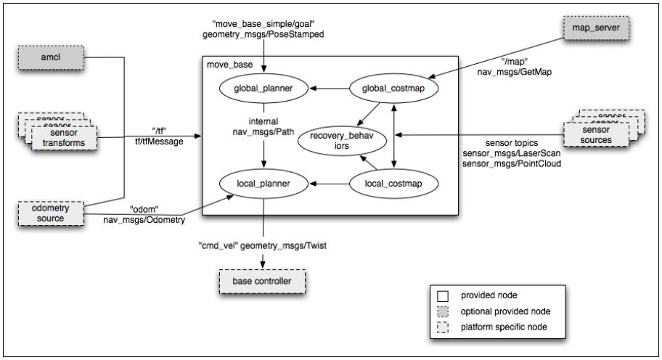
ROS Navigation Stack
courtesy of ROS

Slide 5
ROS Navigation Stack
Build a map
courtesy of ROS

Slide 6
Building a Map
• Before we can start using the navigation stack, we need to provide the robot a map of the world.
• Simultaneous localization and mapping (SLAM) is a technique used by robots to build up a map within an unknown environment while keeping track of the positions.

Slide 7
gmapping
• The gmapping package provides laser-based SLAM as a ROS node called slam_gmapping.
• It takes the laser scans and the odometry and builds a 2D occupancy grid map (OGM)
• It updates the map and publishes it to a topic called /map when the robot moves
• gmapping implements FastSLAM 2.0, which is a particle filtering based algorithm. (refer to paper)

Slide 8
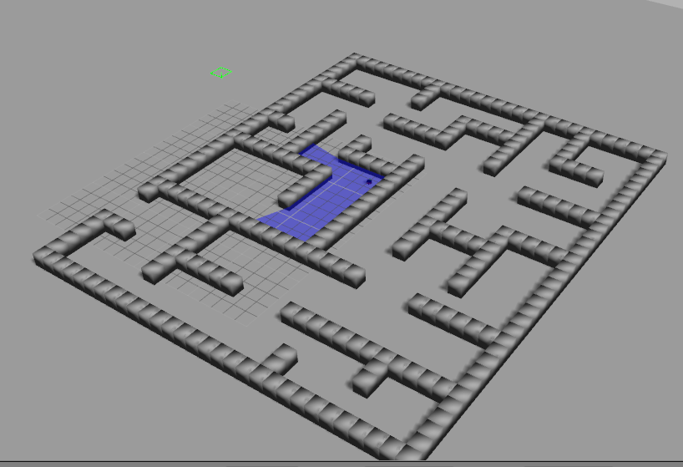
Map Building in Simulator
• Run gmapping:
$roslaunch robot_demos gazebo_world.launch
$roslaunch robot_demos pioneer_robot.launch
$roslaunch robot_demos gmapping_demo.launch
$roslaunch cmd_vel_publisher cmd_vel_publisher.launch

Slide 9
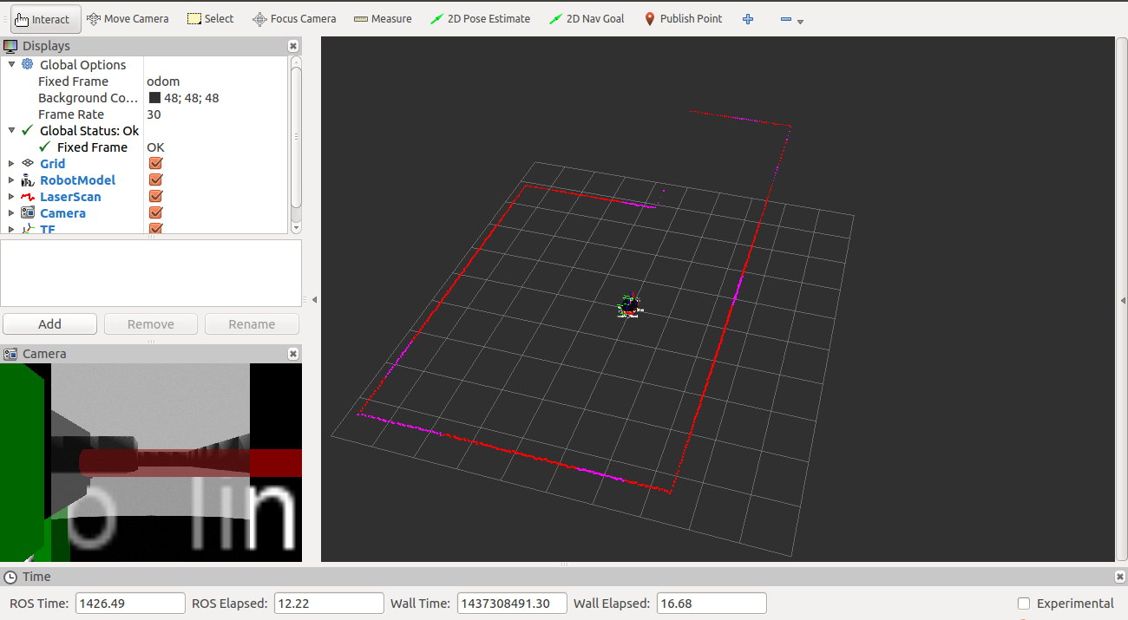
Map Building in Simulator
• Run gmapping:
$roslaunch robot_demos gazebo_world.launch
$roslaunch robot_demos pioneer_robot.launch
$roslaunch robot_demos gmapping_demo.launch
$roslaunch cmd_vel_publisher cmd_vel_publisher.launch

Slide 10
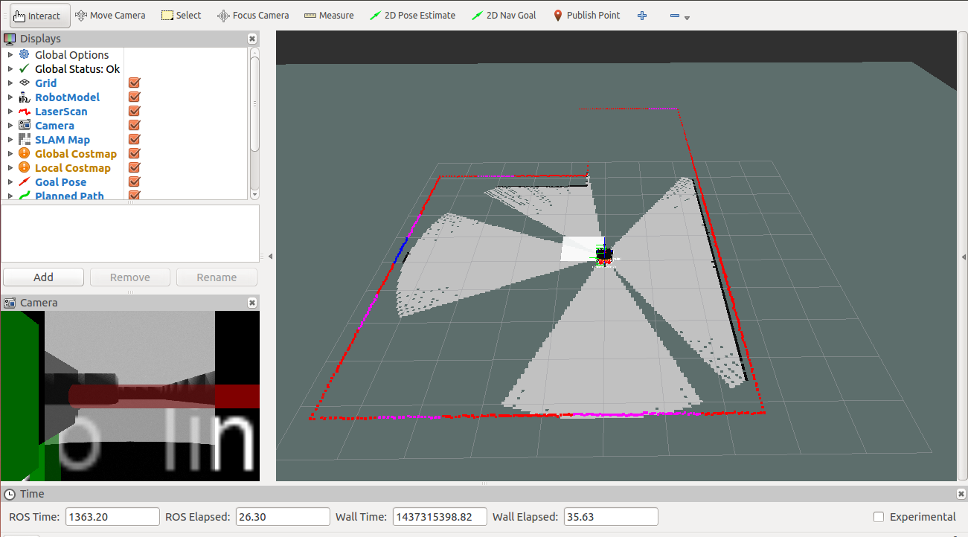
Map Building in Simulator
• Run gmapping:
$roslaunch robot_demos gazebo_world.launch
$roslaunch robot_demos pioneer_robot.launch
$roslaunch robot_demos gmapping_demo.launch
$roslaunch cmd_vel_publisher cmd_vel_publisher.launch

Slide 11
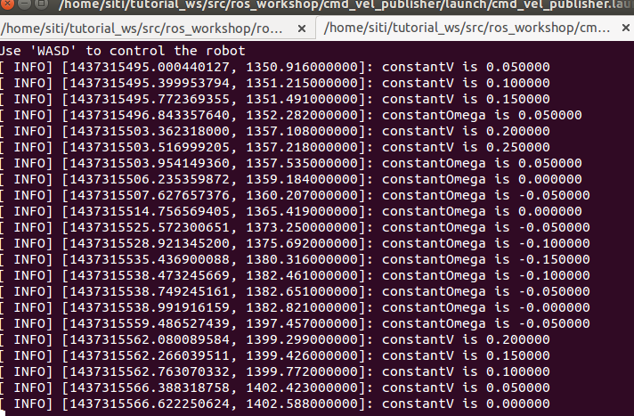
Map Building in Simulator
• Run gmapping:
$roslaunch robot_demos gazebo_world.launch
$roslaunch robot_demos pioneer_robot.launch
$roslaunch robot_demos gmapping_demo.launch
$roslaunch cmd_vel_publisher cmd_vel_publisher.launch

Slide 12
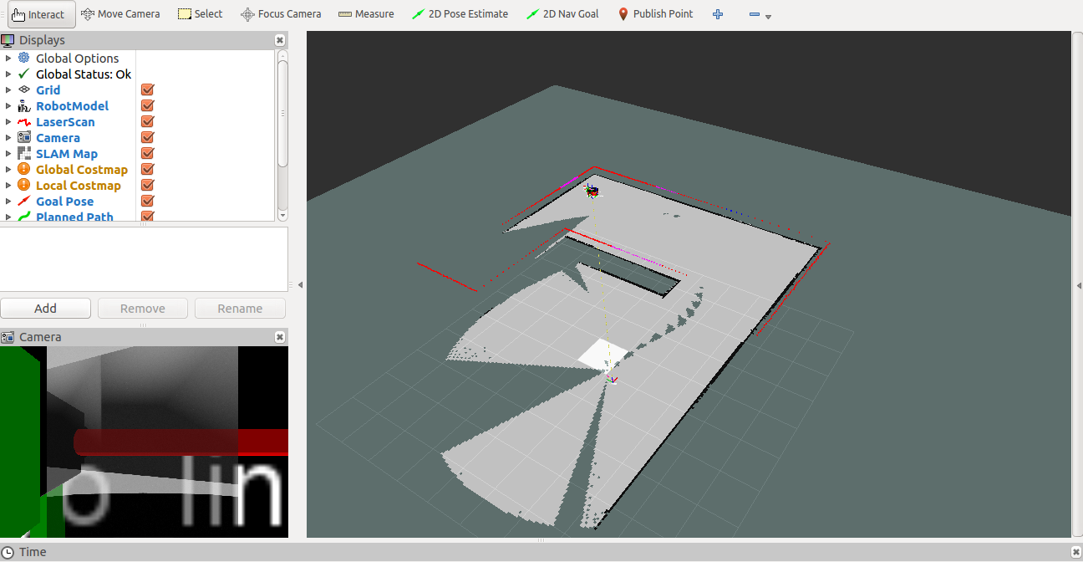
Map Building in Simulator
After moving around:

Slide 13
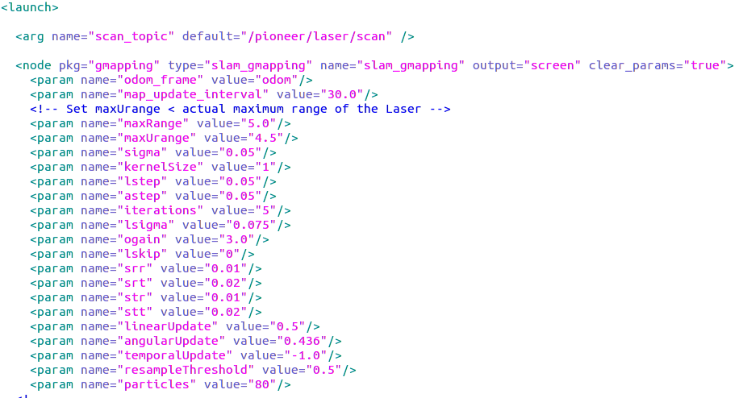
Launch File for gmapping
Many parameters
check wiki.ros.org/gmapping for the meaning of each one

Slide 14
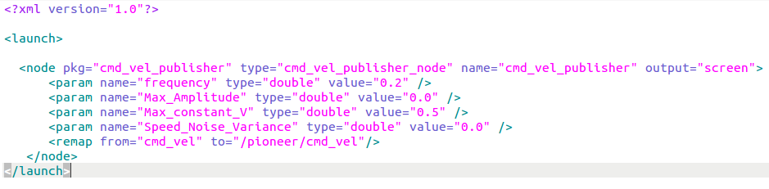
Launch File for cmd_vel_publisher

Slide 15
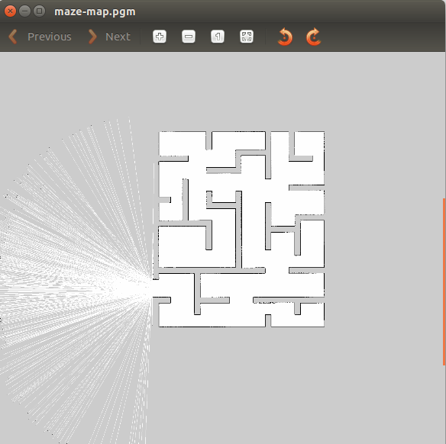
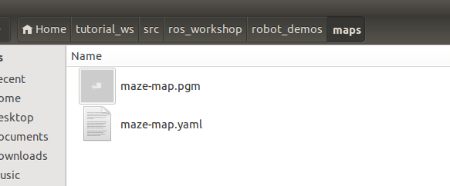
Save map
When the map is finished, save it by using map_server package:
xxxx.pgm and xxxx.yaml in the directory, and view the map (maze-map.pgm) :
$ rosrun map_server map_saver -f ~/tutorial_ws/src/ros_workshop/robot_demos/maps

Slide 16
Map YAML File: maze-map.yaml
image: maze-map.pgm
resolution: 0.050000
origin: [-100.000000, -100.000000, 0.000000]
negate: 0
occupied_thresh: 0.65
free_thresh: 0.196
Important fields:
– resolution: Resolution of the map, meters / pixel
– origin: The 2-D pose of the lower-left pixel in the map as (x, y, yaw)
– occupied_thresh: Pixels with probability greater than this threshold are considered completely occupied.
– free_thresh: Pixels with occupancy probability less than this threshold are considered completely free.

Slide 17
map_server package
• Tools for occupancy grid map
• Map saving:
  – map_saver node allows dynamically generated
maps to be saved to file.
• Map loading (will use later) :
  – map_server node offers map data as a ROS service to load the built map. It also provides the map_saver command-line utility.

Slide 18
ROS Navigation Stack
Once we have built a map, we can try
autonomous navigation based on it.
Load the map

Slide 19
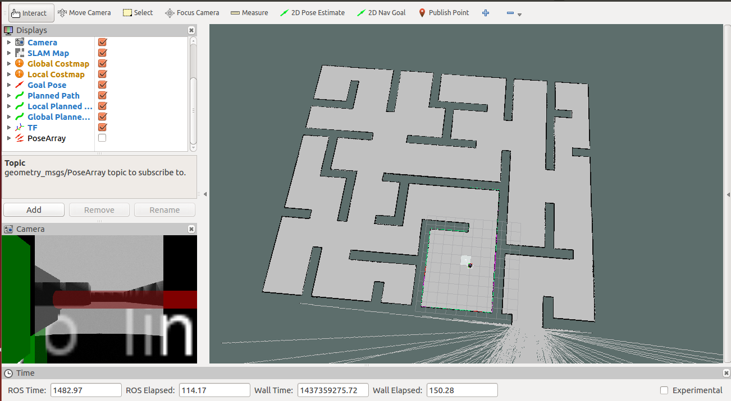
Loading a Map
Run the map_server node to load the built
map by arguments:

Slide 20
ROS Navigation Stack
localization

Slide 21
Localization
• Localization is the problem of estimating the pose of the robot relative to a map.
• Localization is not terribly sensitive to the exact placement of objects so it can handle small changes to the locations of objects.
• ROS uses the amcl package for localization.

Slide 22
amcl
• amcl is a probabilistic localization system for a robot moving in 2D.
• It implements the adaptive Monte Carlo localization approach, which uses a particle filter to track the pose of a robot against a known map.
• As currently implemented, this node works only with laser scans and laser maps.

Slide 23
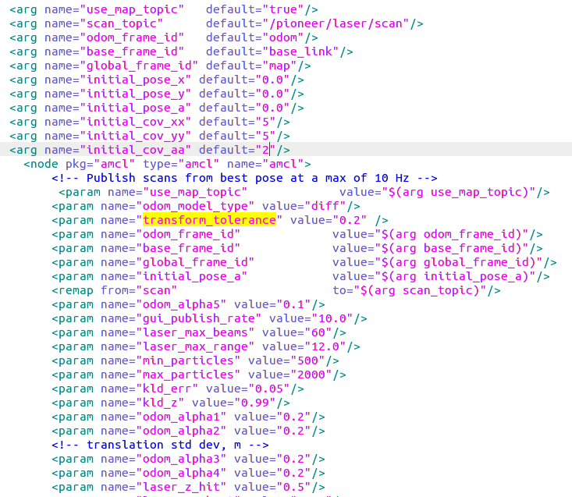
Launch for amcl
......
check wiki.ros.org/amcl for the meaning of each one

Slide 24
Particle Cloud of amcl
• The Particle Cloud displays shows the particle cloud used by the robot's localization system.
• The spread of the cloud represents the localization system's uncertainty about the robot's pose.
• As the robot moves about the environment, this cloud should shrink in size as additional scan data allows amcl to refine its estimate of the robot's position and orientation
• To watch the particle cloud in rviz:
  – Click Add ‘Pose Array’ Display
  – Set topic name to /particlecloud

Slide 25
Using rviz with Navigation Stack
• You can setup rviz to work with the navigation stack. This includes:
– Setting the pose of the robot for a localization system like amcl
– Displaying all the visualization information that the navigation stack provides
– Sending goals to the navigation stack with rviz.

Slide 26
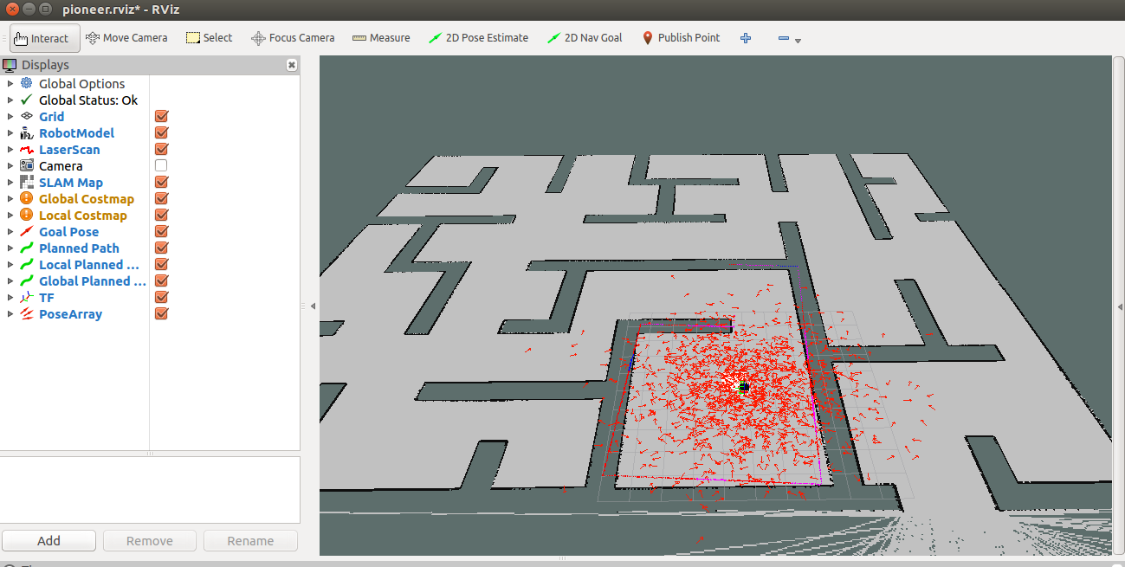
Using rviz with Navigation Stack

Slide 27
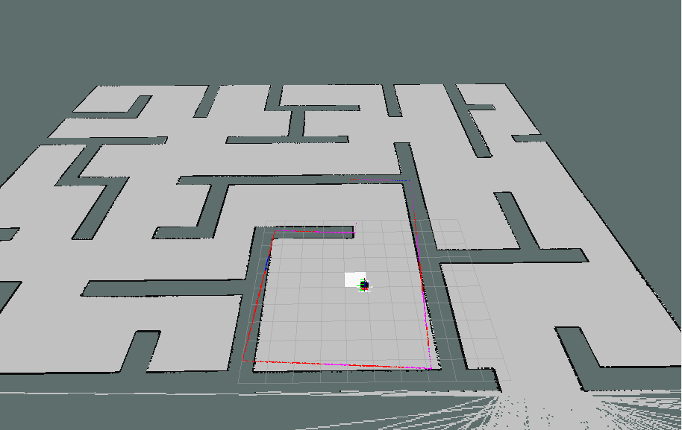
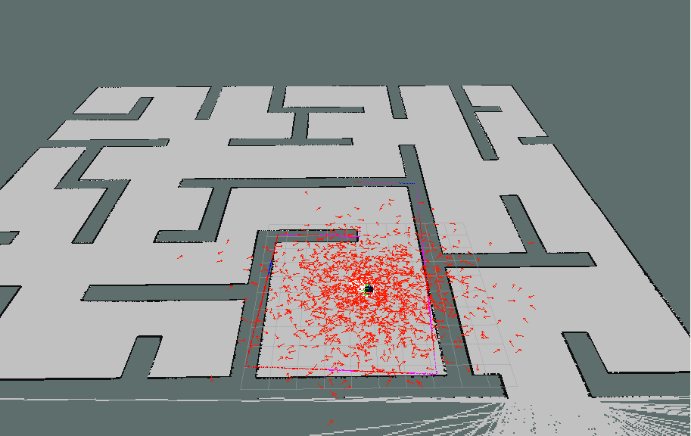
Particle Cloud in rviz
without particle cloud
with particle cloud

Slide 28
ROS Navigation Stack
move_base

Slide 29
move_base
• The move_base package lets us move a robot to desired positions using the navigation stack
• The move_base node links together a global and local planner to accomplish its global navigation task.
• The move_base node may optionally perform recovery behaviors when the robot perceives itself as stuck.

Slide 30
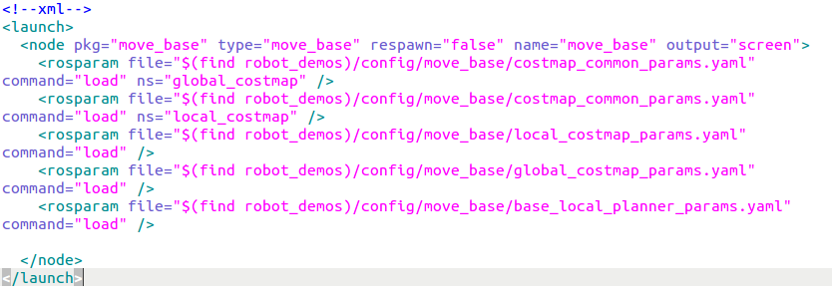
Launch File for move_base

Slide 31
Launch File for move_base
Costmap
There are mainly two modules
– costmap and planner

Slide 32
Launch File for move_base
Costmap
Planner
There are mainly two modules
– costmap and planner

Slide 33
ROS Navigation Stack
Costmap in move_base

Slide 34
Costmap
• The costmap is the data structure that represents places that are safe for the robot to be in a grid of cells
• Usually, the values in the costmap are binary, representing free space or places where the robot would be in collision.

Slide 35
Costmap Types
• Our robot will move through the map using two types of navigation—global and local.
• The global navigation is used to create paths for a goal in the map or a far-off distance
  – The global costmap is used for the global navigation
• The local navigation is used to create paths in the nearby distances and avoid obstacles
  – The local costmap is used for the local navigation

Slide 36
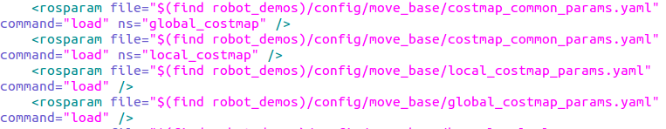
Costmap Parameters Files
Configuration of the costmaps consists of three files where we can set up different parameters:
  – costmap_common_params.yaml
  – global_costmap_params.yaml
  – local_costmap_params.yaml

Slide 37
costmap_common_params.yaml
max_obstacle_height: 0.60 # assume something like an arm is mounted on top of the robot
obstacle_range: 2.5
raytrace_range: 3.0
robot_radius: 0.18
inflation_radius: 0.50
# voxel map configuration; z-voxels 0 are filled by bumpers and 1 by laser scan (kinect)
map_type: voxel
origin_z: 0.0
z_resolution: 0.2
z_voxels: 2
publish_voxel_map: false
observation_sources: scan bump
scan: {data_type: LaserScan, topic: scan, marking: true, clearing: true,
min_obstacle_height: 0.25, max_obstacle_height: 0.35}
bump: {data_type: PointCloud2, topic: mobile_base/sensors/bumper_pointcloud,
marking: true, clearing: false, min_obstacle_height: 0.0, max_obstacle_height: 0.15}

Slide 38
global_costmap_params.yaml
global_costmap:
  global_frame: /map
  robot_base_frame: /base_link
  update_frequency: 1.0
  publish_frequency: 0.5
  static_map: true
  transform_tolerance: 0.5

Slide 39
local_costmap_params.yaml
local_costmap:
global_frame: /map
robot_base_frame: /base_footprint
update_frequency: 5.0
publish_frequency: 2.0
static_map: false
rolling_window: true
width: 4.0
height: 4.0
resolution: 0.05
transform_tolerance: 0.5

Slide 40
Costmap in rviz
• To see the costmap in rviz add a Map display
• To see the local costmap set the topic to:
/move_base_node/local_costmap/costmap
• To see the global costmap set the topic to:
/move_base_node/global_costmap/costmap

Slide 41
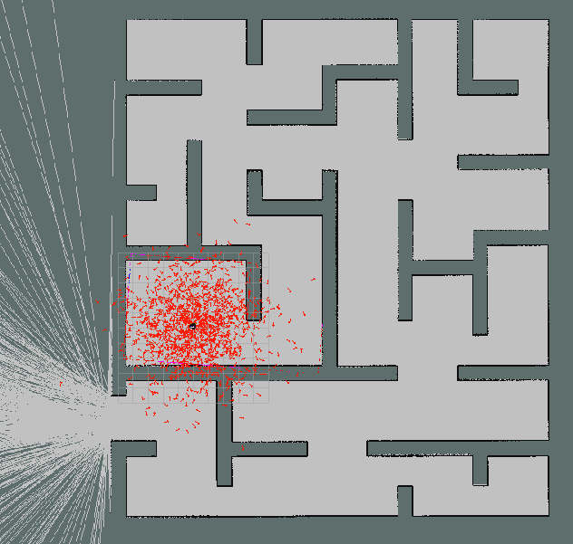
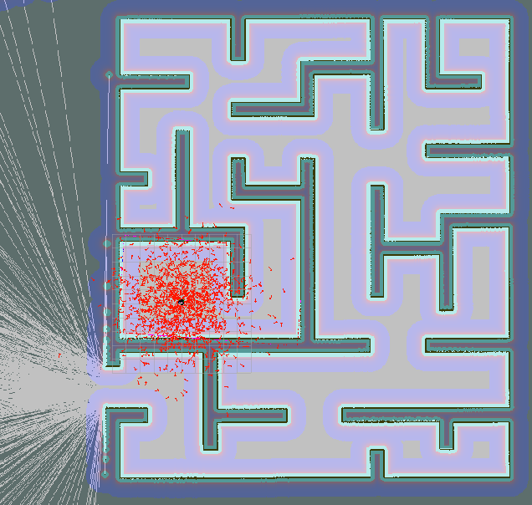
Costmap in rviz
Without global costmap
With global costmap

Slide 42
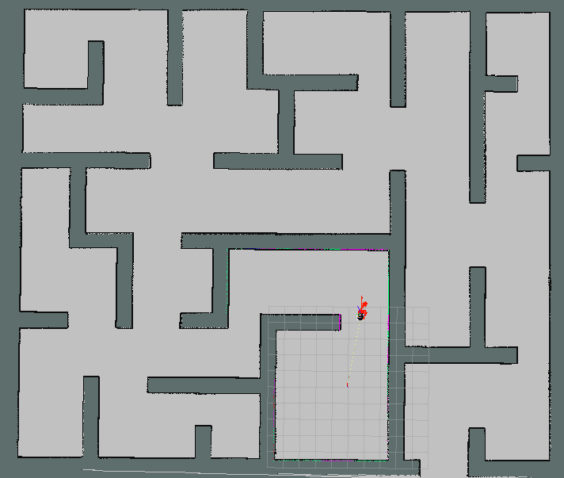
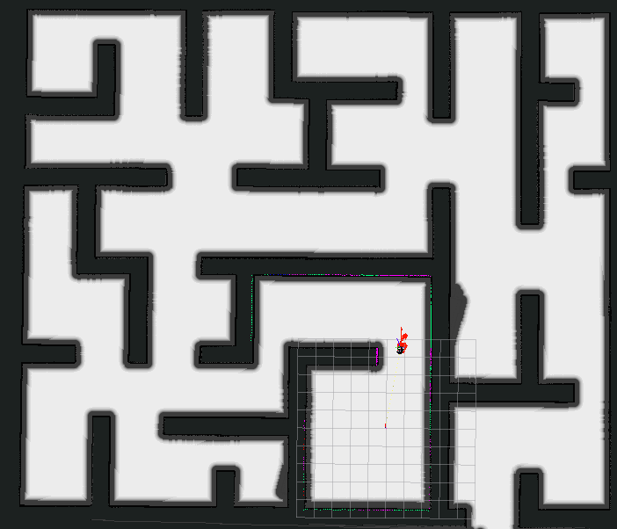
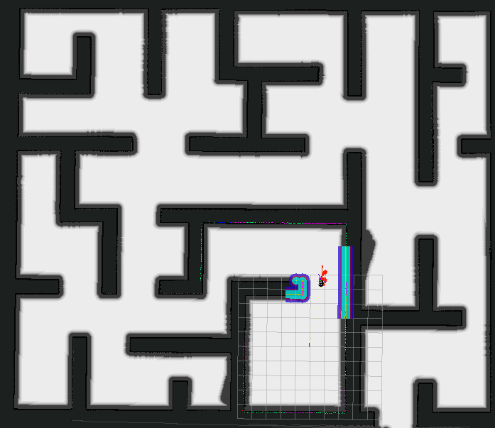
Costmap in rviz
Without costmap
With global costmap
With local costmap

Slide 43
ROS Navigation Stack
planner in move_base

Slide 44
Planner
• The move_base node links together global and local planners to accomplish its global navigation task.
• Global planner: navfn package
• Local planner: base_local_planner package

Slide 45
Global Planner
• The global plan is computed before the robot starts moving toward the next destination
• The planner assumes a circular robot and operates on a costmap to find a minimum cost plan from a start point to an end point in a grid.
• The navigation function is computed using Dijkstra's algorithm

Slide 46
Navfn Published Topics
• navfn package provides a fast interpolated navigation function that can be used to create plans for a mobile base.
• The last plan computed by navfn is published on the topic /move_base_node/NavfnROS/plan everytime the planner computes a new path

Slide 47
Local Planner
• The local planner monitors incoming sensor data and chooses appropriate linear and angular velocities for the robot to traverse the current segment of the global path.
• The base_local_planner combines odometry data with both global and local costmaps to select a path for the robot to follow
• The base local planner can re-compute the robot's path on the fly to keep the robot from striking objects yet still allowing it to reach its destination.

Slide 48
Navigation Plans in rviz
• NavFn Plan
  – Displays the full plan for the robot computed by the global
  planner
  – Topic: /move_base_node/NavfnROS/plan
• Global Plan
  – It shows the portion of the global plan that the local planner is
  currently pursuing.
  – Topic: /move_base_node/TrajectoryPlannerROS/global_plan
• Local Plan
  – It shows the trajectory associated with the velocity commands
  currently being commanded to the base by the local planner
  – Topic: /move_base_node/TrajectoryPlannerROS/local_plan

Slide 49
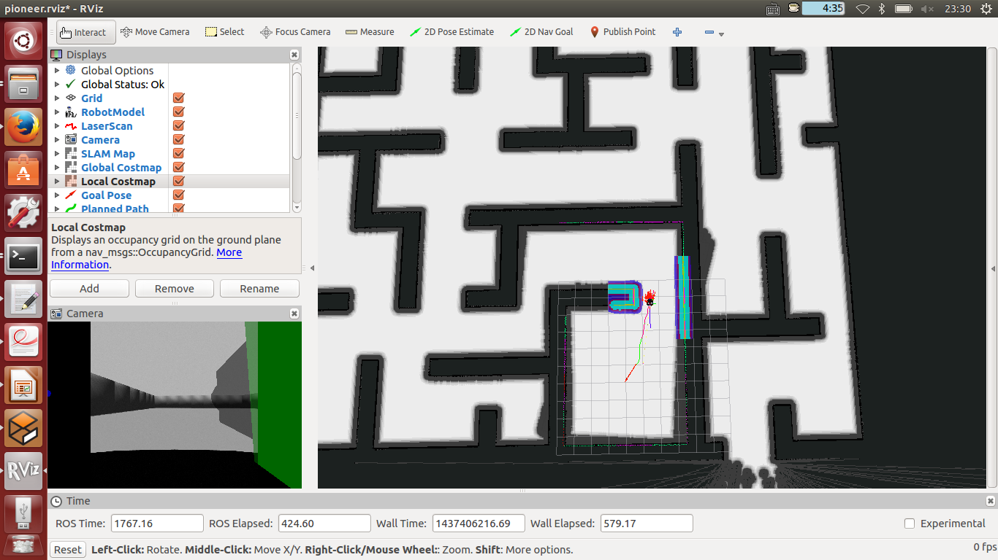
Navigation Plans in rviz
Local Planner
Global Planner

Slide 50
Try: ROS Navigation Stack
$roslaunch robot_demos gazebo_world.launch
$roslaunch robot_demos pioneer_robot.launch
$roslaunch robot_demos amcl.launch
$roslaunch robot_demos move_base.launch

Slide 51
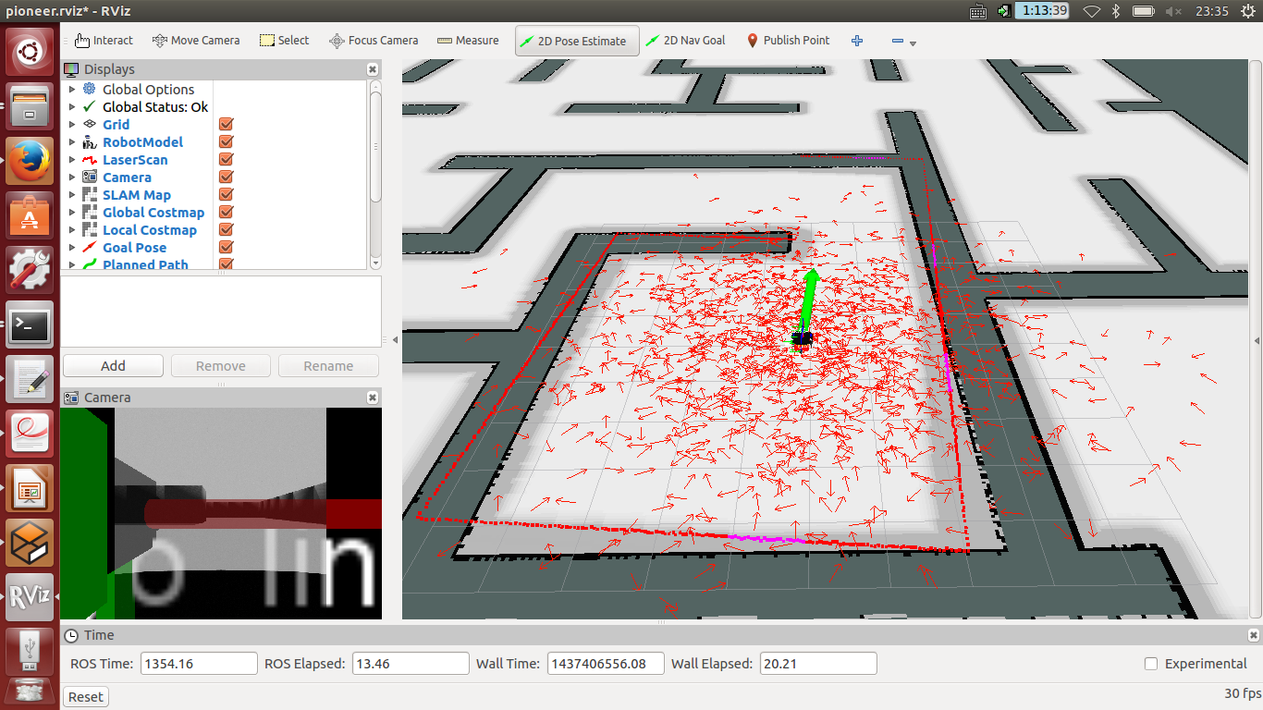
Try: ROS Navigation Stack
Click ‘2D Pose Estimate’ button and click the map to indicate the initial position of robot.
For the "2d Nav Goal" and "2D Pose Estimate" buttons to work, the Fixed Frame must be set to "map".

Slide 52
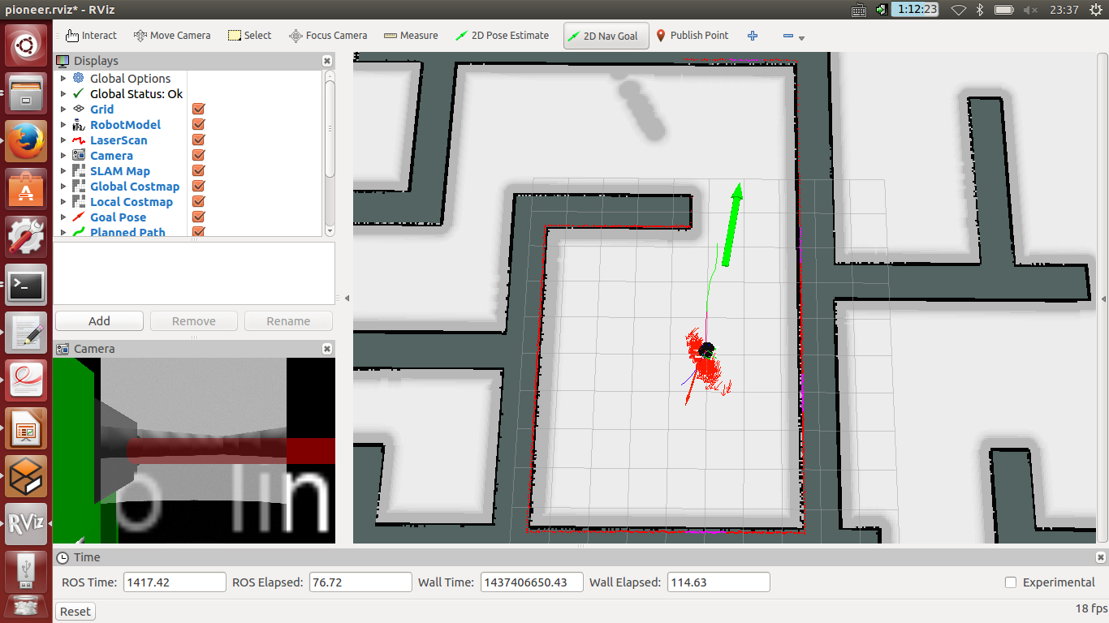
Try: ROS Navigation Stack
Setting goal
Setting goal

Slide 53
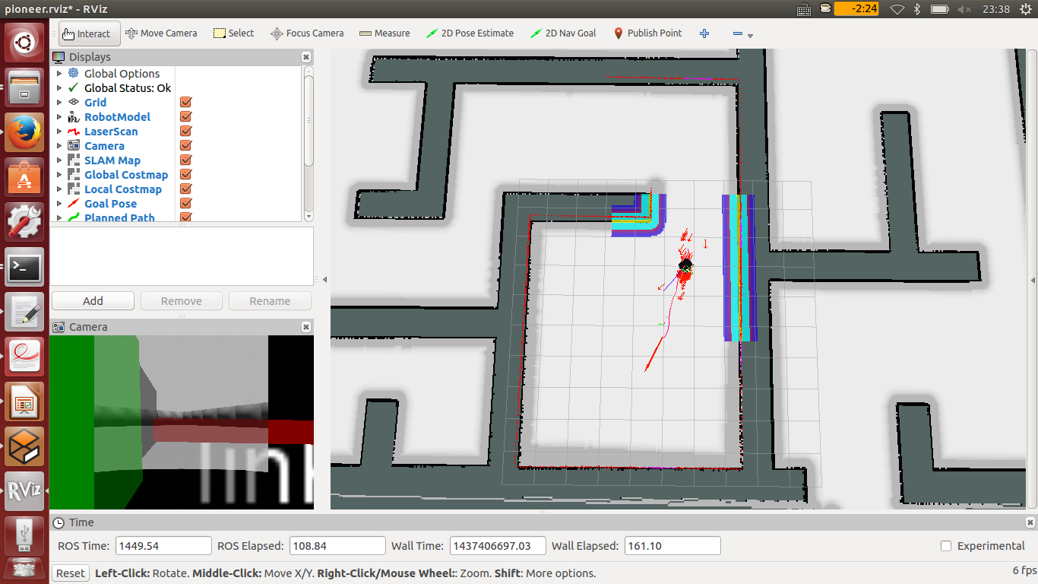
Try: ROS Navigation Stack
Planning
Planning

Slide 54
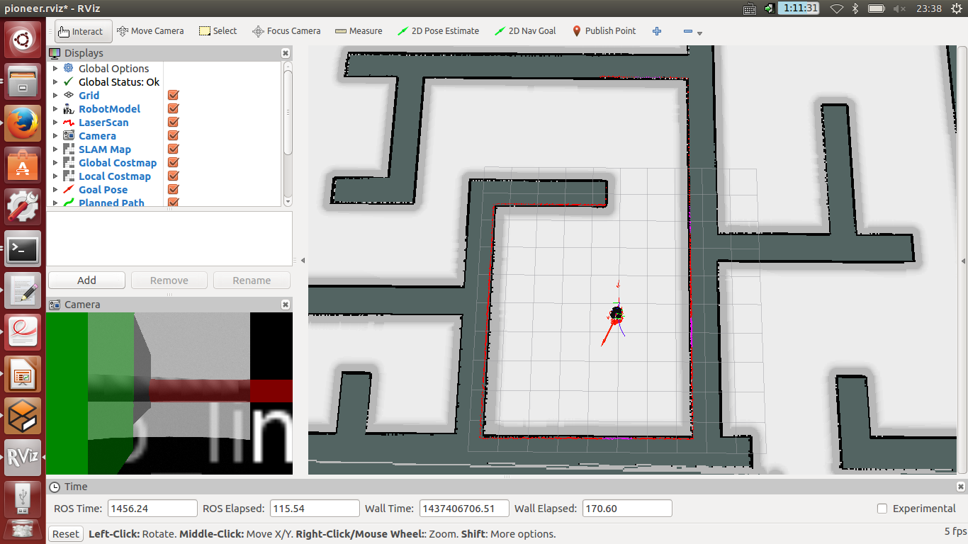
Try: ROS Navigation Stack
Reach the goal
Goal reached

