Slide 1

Gazebo
Ling Chen ( lcheno@shu.edu.cn )
From
Shanghai University

Slide 2
Gazebo
Gazebo
  – is a multi-robot simulator
  – can simulate a population of robots, sensors and objects in a
  three-dimensional world.
  – includes an accurate simulation of rigid-body physics and
  generates realistic sensor feedback
  – allows code designed to operate a physical robot to be executed
  in an artificial environment

Slide 3
Gazebo Features
Dynamics Simulation
  –Direct control over physics engine parameters
Building Editor
  –Construct a 3D model of a building within the Gazebo UI, without writing a line of code
Advanced 3D Graphics
  –State-of-the-art GPU shaders generate correct lighting and shadows for improved realism.
Sensors
  –Support for laser range finders, 2D cameras, Kinect style sensors, contact sensors, and RFID sensors

Slide 4
Gazebo Features
• Robot Models
– Many robots are provided including PR2, iRobot
Create, TurtleBot, generic robot arms and grippers
• Environments
– Access to many objects from simple shapes to
terrain
• Programmatic Interfaces
– Support for ROS
– API for custom interfaces

Slide 5
Gazebo Architecture
• Gazebo runs two processes:
• Server: Runs the physics loop and generates sensor data.
  – Executable: gzserver
– Libraries: Physics, Sensors, Rendering, Transport
• Client: Provides user interaction and visualization of a simulation.
  – Executable: gzclient
  – Libraries: Transport, Rendering, GUI

Slide 6
Running Gazebo
Run Gazebo server and client separately:
Run Gazebo server and client simultaneously:
Run from ROS
$gzserver
$gzclient
$gazebo
$rosrun gazebo_ros gazebo

Slide 7
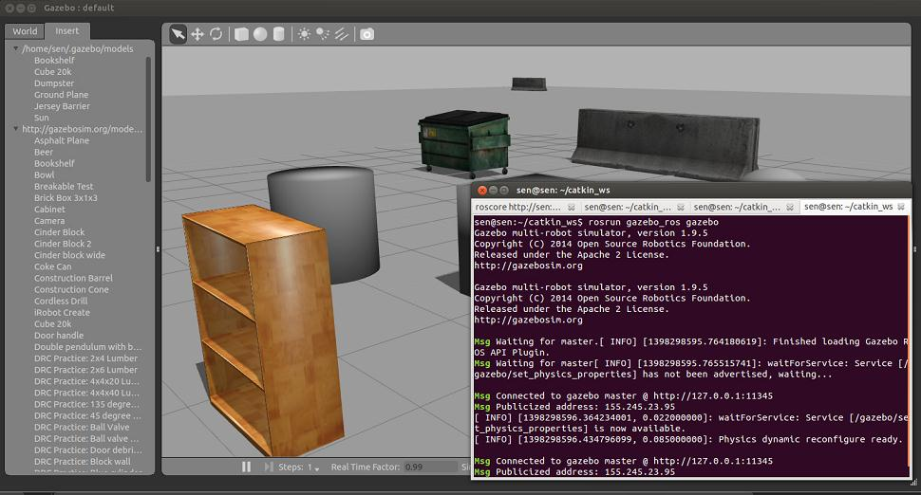
Gazebo Run from ROS

Slide 8
World Description File
• The world description file contains all the elements in a simulation, including robots, lights, sensors, and static objects.
• This file is formatted using SDF (Simulation Description format), and has a .world extension
• The Gazebo server (gzserver) reads this file to generate and populate a world.

Slide 9
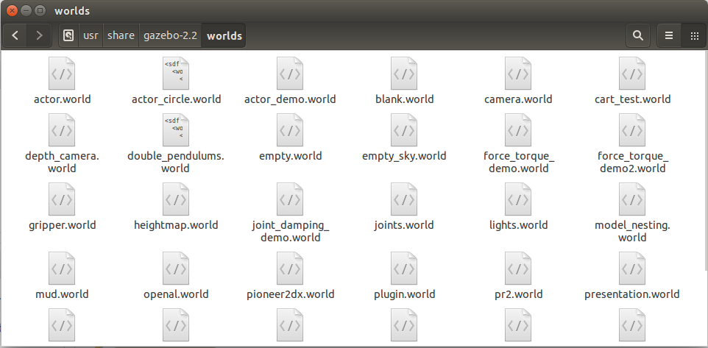
Try: Gazebo
A number of example worlds are available
– /usr/share/gazebo-2.2/worlds
roslaunch to open world models:
– open willowgarage_world:
$roslaunch gazebo_ros willowgarage_world.launch
Note: if model cannot be downloaded, copy to ~/.gazebo/

Slide 10
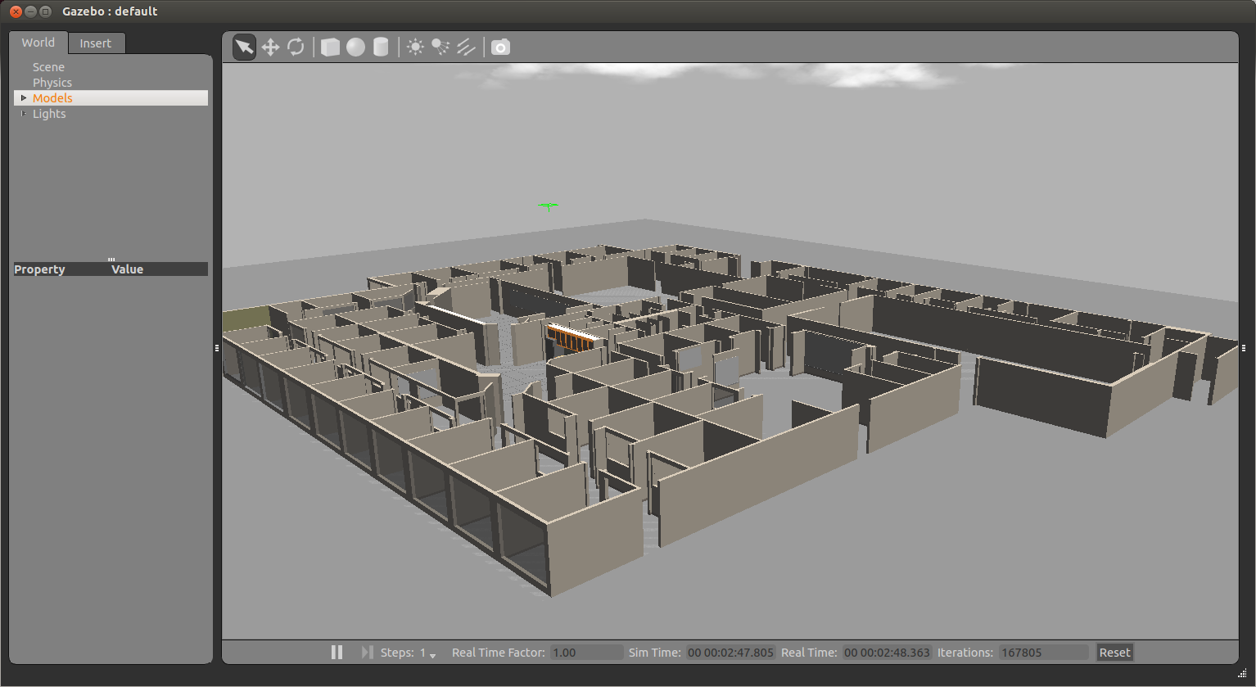
Willow Garage World

Slide 11
How to use Gazebo to simulate your robot
$roslaunch pioneer_gazebo pioneer_world.launch
$roslaunch pioneer_description pioneer_rviz.launch
Steps:
1. load a world;
2. load the description of the robot;
3. spawn the robot in the world
4. publish joints states
5. publish robot states
6. run rviz

Slide 12
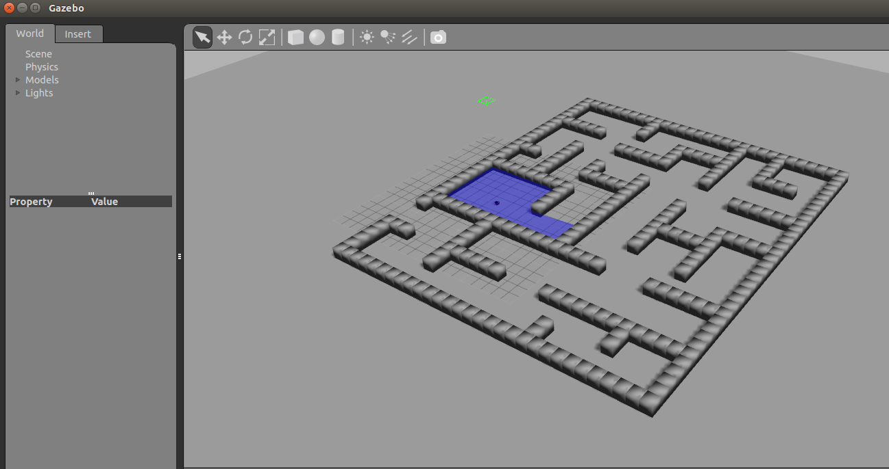
Gazebo: Robot Simulation

Slide 13
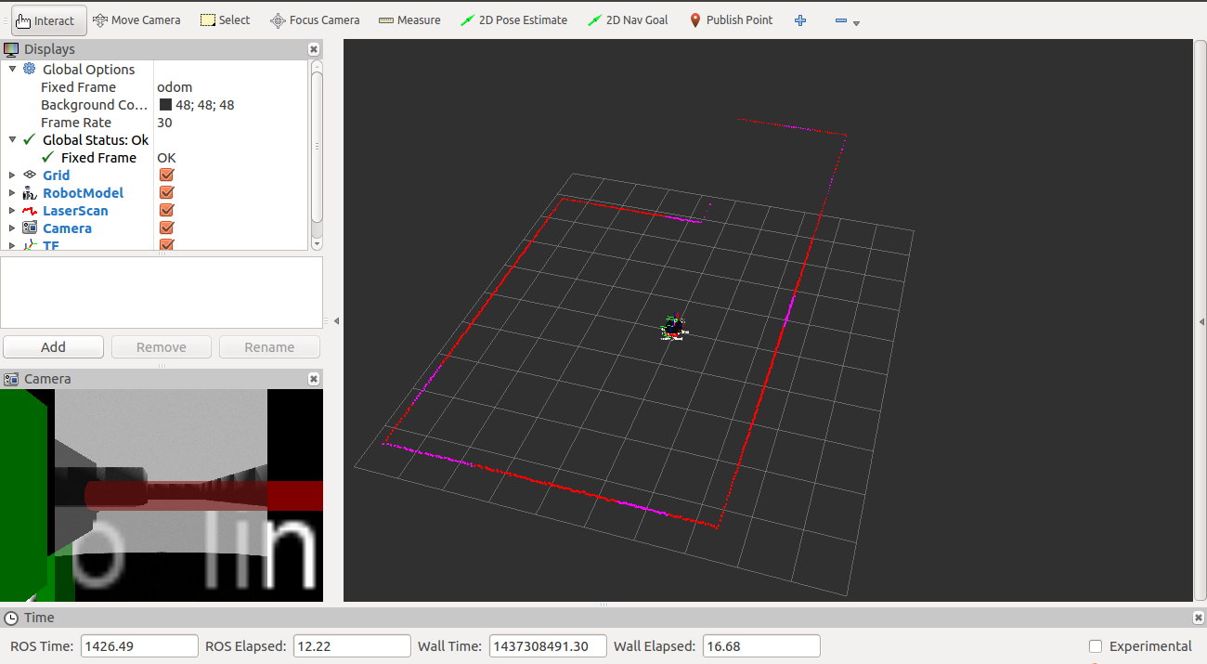
Rviz: Robot Simulation

Slide 14
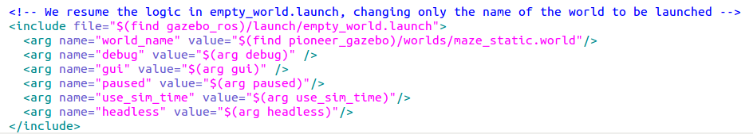
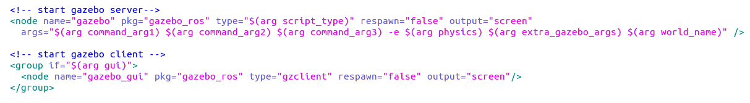
1.Load a world
See file="$(find gazebo_ros)/launch/empty_world.launch"

Slide 15
2. Load the description of the robot
Using xacro:
Xacro (XML Macros) Xacro is an XML macro language. With xacro, you can construct shorter and more readable XML files by using macros that expand to larger XML expressions.
More details: http://wiki.ros.org/xacro
From solidworks to URDF?
See http://wiki.ros.org/sw_urdf_exporter

Slide 16
3. spawn the robot in the world
By running node spawn_model of gazebo_ros package

Slide 17

4. publish joints states

Slide 18
5. publish robot states

Slide 19
6. run rviz

Slide 20
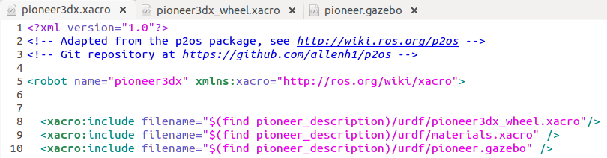
How does sensor work in Gazebo
How do these three sensors work in Gazebo?
1. Laser
2. odometry
3. Camera

Slide 21
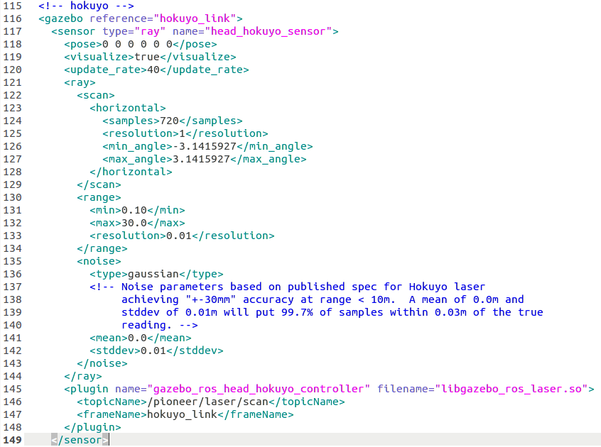
Laser
Using Gazebo plugins with ROS:
http://gazebosim.org/tutorials?tut=ros_gzplugins

Slide 22
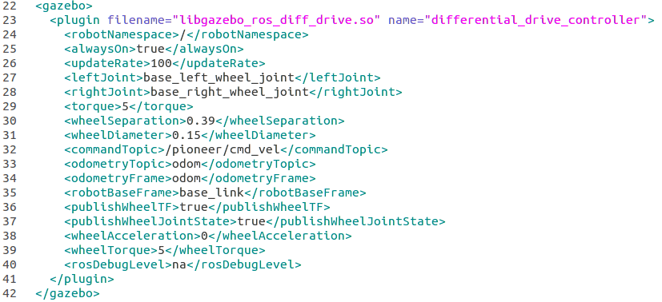
Odometry
Link for the code: http://docs.ros.org/jade/api/gazebo_plugins/html/gazebo__ros__diff__drive_8cpp_source.html
http://docs.ros.org/indigo/api/gazebo_plugins/html/gazebo__ros__diff__drive_8h_source.html

Slide 23
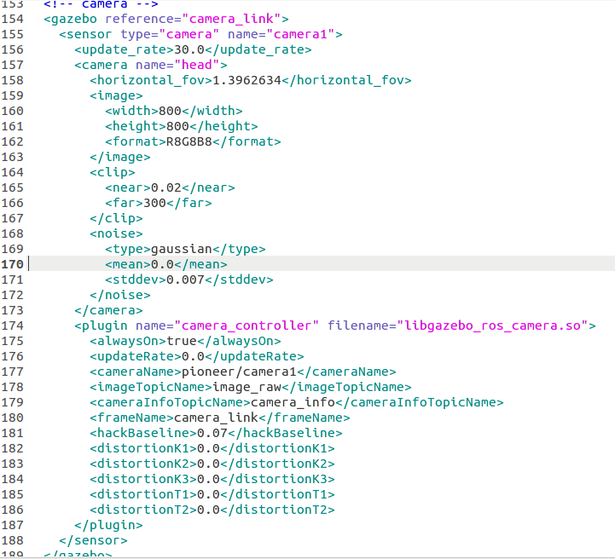
3. Camera
Link for the code:
http://docs.ros.org/diamondback/api/gazebo_plugins/html/gazebo__ros__camera_8h_source.html
http://docs.ros.org/indigo/api/gazebo_plugins/html/gazebo__ros__camera_8cpp_source.html

Slide 24
Example: Robotic fish
Video:

